Slide 1
Evaluating AI model performance
March 2, 2026
Nathan Carter
CS 399: Innovating with AI

Slide 2
Where we ended last time
Criterion | Meaning | How to check
Task | Does it do what I need? | Covered last week
Size | Does it run on my hardware? | Done today
Speed | Does it run fast enough? | Try it and see
Quality | Does it give good output? | Next class!
And now here we are.

Slide 3
Three example evaluation types

Slide 4
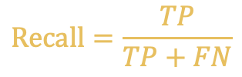
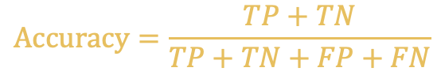
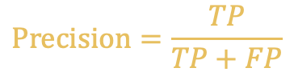
evaluative tools #1: Binary classification
Binary classification: You’re trying to predict a yes/no response
TP = True positives = Reality and prediction are both positive
FP = False positives = Predication was positive, reality is not
TN = True negatives = Reality and prediction are both negative
FN = False negatives = Predication was negative, reality is not
$$Accuracy=\frac{TP+TN}{TP+TN+FP+FN}$$
How often is it correct?
$$Recall=\frac{TP}{TP+FN}$$
If the answer is Yes, can it tell?
$$Precision=\frac{TP}{TP+FP}$$
If it says Yes, is it right?

Slide 5
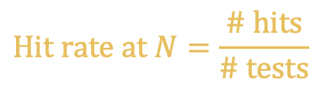
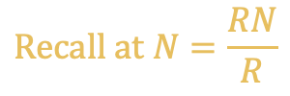
evaluative tools #2: Search
Search: You’re responding to a query, returning a list of “documents”
N = How many results do we count as “top” results?
R = the number of relevant search results for some selected query
RN = the number of relevant search results for that query that show up in the top n
Hit = true if RN > 0 (Did we find anything relevant?)
$$Hit rate at N=\frac{\# hits}{\# tests}$$
How often is any top result good?
$$Recall at N=\frac{RN}{R}$$
What portion of top results
are good?

Slide 6
evaluative tools #3: Text output
Construct some “golden test cases,” in which you know the correct response.
Also construct a rubric for grading whether you would call a model’s response correct, partially correct, incorrect, etc.
Report:
a table of test cases: input → expected result → actual result
Counts of pass/fail/intermediate
Analysis of any surprising successes or failures

Slide 7
Brainstorming process

Slide 8
Divergent/convergent thinking
Brainstorm (divergent)
Add constraints
(convergent)
Brainstorm (divergent)
Add constraints
(convergent)
Brainstorm (divergent)
Add constraints
(convergent)

Slide 9
Q1, Dream: If your product became a reality, what metrics would you use to verify that it was solving the client’s problem?
“Dream” means you don’t have to be able to implement this now.
Frame answers in terms of the client’s business needs.
Let this exercise orient you towards a definition of “good” for your product.

Slide 10
Q2, Reality: what limitations must you impose because your CS399 project is a prototype, without real clients/customers/data?
Example: Because we can’t ask a customer X, instead we will…
Example: Because we don’t have live data, instead we will…

Slide 11
Q3, Dream: Imagine you had plenty of capital and staff to spend on model evaluation. What evaluation mechanism would you use?
Goal:
Create a useful and accurate metric.
Align it with your definition of good from Q1.
Stay within the constraints you gave in Q2.
Dream:
You can buy whatever computing/data resources you need.
You can assign your staff to do whatever labeling/judging tasks you need.

Slide 12
Q4, Reality: What scaled-back version of that strategy could you use in CS399 without capital/staff?
Example: Because we don’t have staff to grade chat responses, instead we will…
Example: Because we can’t buy 10,000 API calls, instead we will…

Slide 13
Exercise: evaluation design

